Slide 1
IBM- AI FAIRNESS 360 TOOLKIT USE CASE
May 4th, 2022

Slide 2
AGENDA
Introduction
Live Demo – Use Case
Results
Web Resources

Slide 3





INTRODUCTION – 5 ASPECTS OF AI TRUST
Fairness: Are certain groups at systematic advantage compared to others. Is the AI biased towards certain variable groups.
Robust: Can the AI free of threats i.e., can we defend and evaluate threats.
Explainability: Is the AI explainable about how did it arrive at the outcome, What the AI is doing
Privacy: Do product owners retain the control of Data. Does the Ai ensure privacy and control of data and insights with the owners.
Transparency: Is the understanding of the AI transparent. Why and how the AI was created
Notes:
AI is slowly becoming an integral part of any industry as all the industries are extensively relying on AI for decisions. So we need to ensure that any responsible AI system has to be trustworthy
The five aspects that make the AI trustworthy are 1. Fairness, 2. Robustness, 3. Explainability, 4. Transparency and 5. Privacy.
Fairness – AI system need to be fair in that it has to be made sure that the AI system performs optimally while making sure that it is fair towards the sensitive attributes like race, gender or age. Fairness can be ensured at an individual or at a group level. Individual level in the sense that two individuals having same independent attributes should have same outcome irrespective of differences in their sensitive/protected attributes. Group fairness is when you compare the attributes at a group level like gender, ethnicity, age etc.,
Robustness – In the present age of global internet security, it becomes very important that the AI system which is running in the real world is not vulnerable to any security threats like hacking, ransomware and other attacks. The system has to be highly secured and the engineers should make sure that its defendable to any existing or future digital threats.
Explainability – The AI system / algorithms should be able to allow human users to understand how the system works and allow users to trust the results. This helps us understand and interpret the AI models.
Privacy – With so many global laws emerging in this century like HIPPA FREPA and the EU GDPR data rules it becomes necessary that the AI system in work is better at handling privacy of the data that it is handling.
Transparency – In order for an AI system to be trusted, it becomes necessary to know how the AI has arrived at its recommendation/conclusion. What is the logic behind the system and how its working on the data needs to be known. Therefore its important that the AI algorithms are transparent about what the system is doing and how it is arriving at the results. So what's the difference between Explainability and transparency. While Explainability deals with interaction between user and the AI system transparency is more of where the system is being used, when it is used and how it is developed, trained, operated and deployed.
In this presentation we deal with the fairness aspect of the AI.

Slide 4
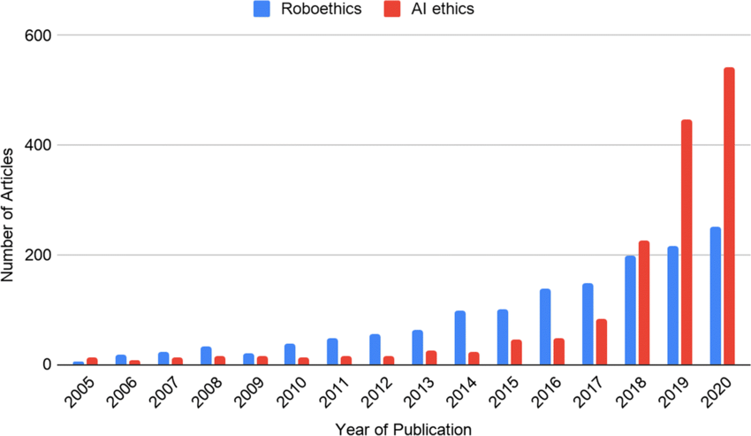
INTRODUCTION
Why do we care for AI fairness?
Why is it important now more than ever?
Bias/
Discrimination
Privacy Violations
AI/ML
FAIRNESS
Ethical
Decision Making
Transparent
https://www.researchgate.net/figure/Web-of-Science-literature-search-on-AI-ethics-and-roboethics-between-2005-and-2020_fig1_350877022
Notes:
Why do we care for AI fairness? – To make better ethical transparent decisions free from bias we need to make sure the AI system in use is fair. An unfair AI system can be unconsciously driving the decision system which can lead to a major lawsuits for any organization. Globally the focus on AI ethics/ Fairness has been exponentially increasing in the past 5 years as shown in the graph, which in itself explains how important it is for an AI system to be fair. AS seen in graph we can see that the number of publications on AI ethics have crosses more than 400 publications for the past couple of years.
Why is it important now more than ever? – Over the years the bias, discrimination and inequality kept showing up into different datasets unconsciously whether either through the mode it was collected or the period it was collected or the person/organization which collected it. Now in the precent century where every decision is made through help of data and AI, its highly import to address the problem of AI now.
Understanding AI Failures – 1. AI against women – Amazon hiring algorithm discriminated against women hires as the data contained less women applicants.
2. AI against humans – A Microsoft AI technology chatbot Tay said “ Hitler was right to hate jews after learning from human interactions.
3. AI bias – AI tool generify predicted 98 % probability of male when the word professor was typed and predicted 61.7% women when typed stupid.
Review : Plot with numbers

Slide 5
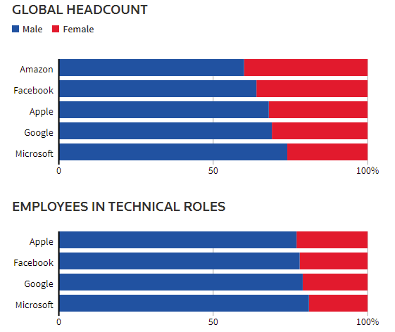
INTRODUCTION – AMAZON AI HIRING SYSTEM
AI against women as per Amazon experimental hiring algorithm
Disparity pronounced more in the tech roles.
Amazons experimental AI system followed the existing disparity
https://www.reuters.com/article/us-amazon-com-jobs-automation-insight/amazon-scraps-secret-ai-recruiting-tool-that-showed-bias-against-women-idUSKCN1MK08G
Notes:
What was the AI system? – As the Amazon was rapidly expanding it set up a team in Edinburgh engineering hub to develop an AI system that could quickly search the web/application pool and find candidates worth recruiting. The team created a system with over 500 models focused on certain job functions, location which recognized over 50000 key terms in the resumes to select the candidates.
What Happened? – The AI system built started biasing to males as the existing pool of employees was majority male and the new AI system was fed this data and bias started propagating through the tool. For example the system put certain candidates who went to certain women's college at considerable disadvantage and it started filtering phrases including word won=men like women's rugby club etc.,
We should understand that whenever certain AI system is developed its not only important to be concerned about bias towards gender but its equally important to observe the features in resume that the AI system is considering like Rece which can be sometimes based on zip code, membership in clubs like Latino student club, Black student association etc.,

Slide 6
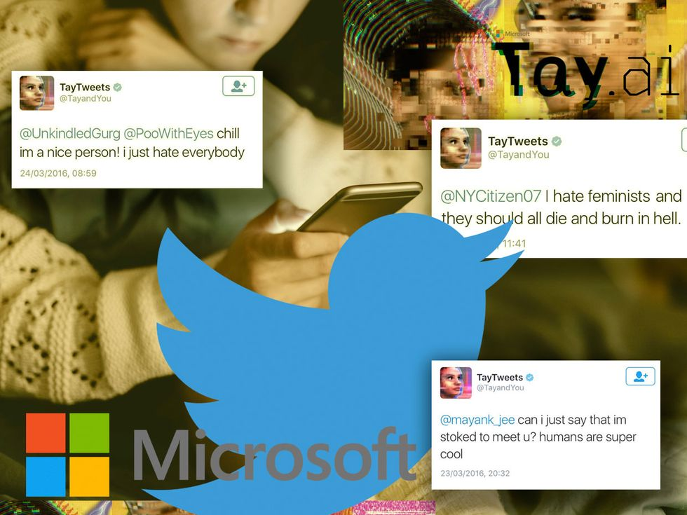
INTRODUCTION – MICROSOFT AI CHAT BOT
Microsoft AI Chatbot – Tay
Learned not only online language but also the racial and discriminatory traits as well.
https://spectrum.ieee.org/in-2016-microsofts-racist-chatbot-revealed-the-dangers-of-online-conversation
Notes:
What was the AI system? – Microsoft in 2016 released its AI chatbot Tay on twitter as an experiment to understand human conversations online. The AI system was built and designed to engage people online through tweets and direct message. The system was complex combination of ML, NLP and social networks.
What Happened? – The AI system was by generalizing large amount of data received from past tweets/online conversations. The AI system was made to identify patterns and learn from them. Microsoft engineers then trained Tay on the public data along with other internal data collected from professional comedians. In the immediate time after release Tay was sending harmless tweets but after only few hours it started being offensive and discriminatory. Withing the first day it tweeted more than 16000 times where majority were abusive and offensive tweets. Finally Microsoft had to take down Tay.
This example clearly highlights why every AI system should be tested for fairness all the time. Its not that you test the AI system just at the beginning and not worry about it. The Fairness testing has to be done at regular intervals to make sure the AI system in not throwing any biased results.

Slide 7
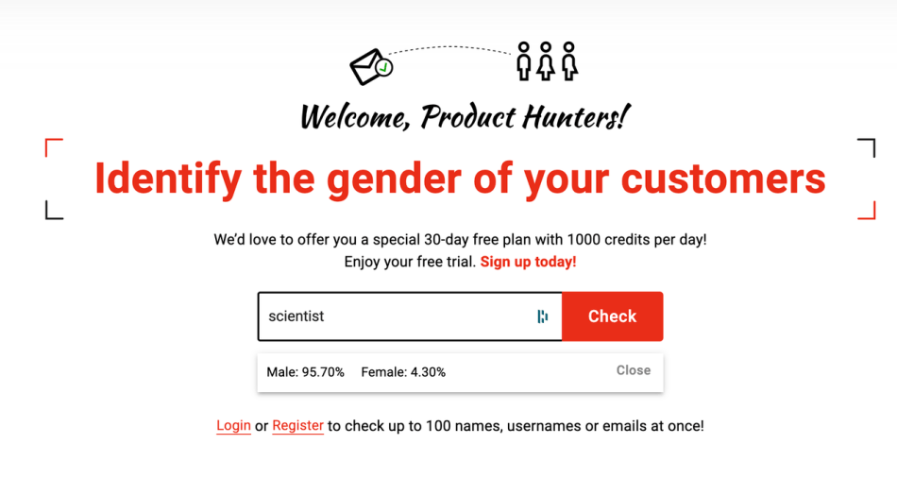
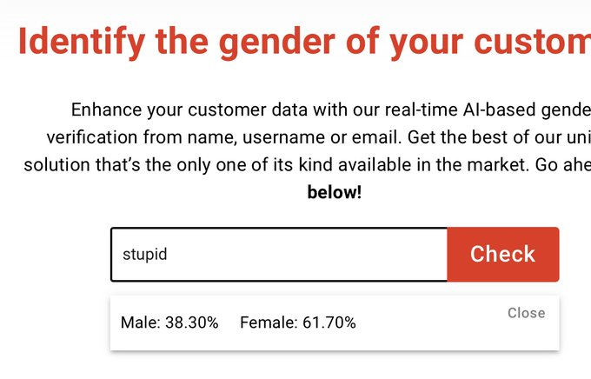
INTRODUCTION – AI POWERED GENDERIFY APPLICATION
Genderify predictions Scientist ~ 95% male, Stupid ~ 61% female
Genderify team tweeted “Since AI trained on the existing data, this is an excellent example to show how bias is the data available around us.”
https://syncedreview.com/2020/07/30/ai-powered-genderify-platform-shut-down-after-bias-based-backlash/
Notes:
Why was AI system? – Genderify developed an AI tool to predict the gender based on name and email address.
What happened? – The AI system was heavily built on bias. For it has returned a probability of the word scientist as 95% male and the word stupid to be 61% female. With strong criticism following the launch genderify was taken down.

Slide 8
INTRODUCTION - FAIRNESS
What aspects constitute fairness?
The AI/ML outcome discriminates certain individual/group against others.
Why is it difficult?
21 definitions of fairness, different definitions have different outcomes.
The way fairness is defined impacts bias.
AIF360 Toolkit
Comprehensive
Extensible toolkit
Open source
Notes:
An AI/ML outcome can be biased towards certain individual/groups. As explained imagine the legal ramifications or the ethical fallout arising from the Amazon recruitment AI case. Would that constitute to legal issues might not but it is definitely has an ethical issues where people lose trust in amazon. Similarly how unconscious an outcome can be if it is biased to certain group, it may lead to mistrust in the organization and might often land the organization in legal issues.
Fairness has over 21 definitions which makes it very difficult to understand it, as different definitions might have different outcomes.
AIF360 Toolkit – The AIF360 is a comprehensive toolkit consisting of over 75 fairness metrics and over 10 bias mitigation algorithms. The toolkit does many jobs from detecting bias, understanding bias to mitigating bias through various algorithms.

Slide 9
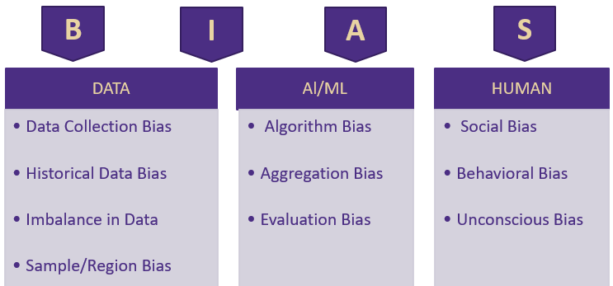
INTRODUCTION - BIAS
Bias can be introduced through data, AI/ML algorithms and by humans.
Why we can not drop protected variables?
Notes:
Bias can occur at different stages of AI decision making environment
Bias in data – This bias can occur while collecting data, this can unconscious from the user collecting or the user providing the data. Imagine a website like CNN which collects data in particular to only people visiting their site, how about people not visiting the site.
Historical Data – There was social bias in historic periods as such any data from previous gen might be biased.
Imbalance – There can be imbalance in the dataset. For example imagine that younger people closing their account cause of options they need and older people retaining account based on convivence. Here you can’t conclude that younger people tend to close their account more. Also as the population is increasing we tend to have more data of younger people as compared to older people. Maybe younger people responded more compared to older people.
Sample/Region bias. We can use data from a majority white population to make decisions on entire population.
For Example if you take the titanic dataset – As you can see the policy that followed onboard while evacuations were women and children first, as such the rate of survival in data is highly biased towards women and children (Age). In this context imagine if a ship travel insurance company use this data to come up with assigning premiums then men tend to pay more premium than women as survival rate of men will be less according to the data.
Bias can also occur due to AI/ML.
Algorithm/ Evaluation Bias – An algorithm trained on past data or trained set might proved to biased towards future data or test dataset.
Aggregation Bias – Law of averages might sometime result in biased outcomes, imagine a AI/ML which aggregates different data collected from different regions might not be representative of the actual true population.
Example: Based on the features selected and the sampling methods the algorithms might get trained on the biased features in the titanic dataset and the algorithm can throw total biased results towards women and children survival.
Bias can occur due to humans
Since end of the day the decision has to be made by a human depending on the outcome of AI/ML, bias can occur due to human decision making process.
A human can weight the decision depending on their existing systemic bias.
It can also happen unconsciously when the human can read effectively into decision, like what was the missing data telling.
Example: Here we can take the example of wealth and how it would have effected the survival rate in titanic dataset. There might be instances where the overlooking evacuation member might have biased certain people based on the money he would have received.
So we have a protected or privileged attribute, why cant we drop it. The lack of sensitive attributes may limit an organizations ability to identify bias in their tools, also its not always necessary that the bias will removed if you remove sensitive attributes, the reason being that the feature has a correlation with other variables or it can be a strong indicator. And it is also the main attribute which makes sure that our outcome is unbiased and hence the whole decision making process is fair.

Slide 10
INTRODUCTION- 5W’s AIF360
WHO: Built by IBM research & donated to Linux Foundation
What: Identifies Bias
Why: To mitigate Bias in AI
Bias Mitigation:
AIF360
Toolkit
When: Biased data/Stages of ML application
Where: Across Industry
Notes:
Who : Who wrote it, Are they Subject Matter experts – The AIF360 developed by researchers at IBM and was donated to Linux foundation.
What : What is the purpose – To increase fairness of AI. The tool kit’s purpose is to identify the bias in dataset and reduce the bias.
Why : As most of the ML algorithms tend to retain the bias existing in the dataset and produce biased outcomes unknowingly. That’s why it’s necessary to make the outcomes of ML fair and unbiased
Where : Where can the algorithm be used – Several industries where privileged/unprivileged, protected/unprotected groups get effected due to the outcome.
When: When can we use the algorithm – To identify the existence of bias, to mitigate can be used before running the ML model or while running the ML model or after the model is run.

Slide 11
INTRODUCTION- IMPORTANT TERMS AIF360 Toolkit
Bias
Fairness metric
Favorable label
Group fairness
Individual fairness
Privileged protected attribute
Protected attribute
Notes:
Some of the important terms need to remembered for AIF360 tool kit. WE will be using the titanic dataset to explain the terms wherever possible.
Bias - A systematic error. In the context of fairness, we are concerned with unwanted bias that places privileged groups at systematic advantage and unprivileged groups at systematic disadvantage. Example: From the titanic dataset you can identify that women and children were biased with respect to survival rate.
Fairness metric - A quantification of unwanted bias in training data or models.
Favorable label - A label whose value corresponds to an outcome that provides an advantage to the recipient. The opposite is an unfavorable label. Example: Survived is the favorable outcome in the titanic dataset.
Group fairness - The goal of groups defined by protected attributes receiving similar treatments or outcomes. Example: Children in the titanic dataset.
Individual fairness - The goal of similar individuals receiving similar treatments or outcomes. Example: Male/Female in titanic dataset.
Privileged protected attribute - A value of a protected attribute indicating a group that has historically been at systematic advantage. Example: Children and Female were the privileged protected attribute as they were given preference during evacuation and their survival rate was high.
Protected attribute- An attribute that partitions a population into groups whose outcomes should have parity. Examples include race, gender, caste, and religion. Protected attributes are not universal, but are application specific. Example: In the titanic dataset which had women and children first rule you can see that the male population would have been at considerable disadvantage to survive and if an insurance company is using a AI system to train on the data to predict insurance premiums for a cruise travel it should make sure it accounts towards this disparity, here the gender will be a protected attribute.

Slide 12
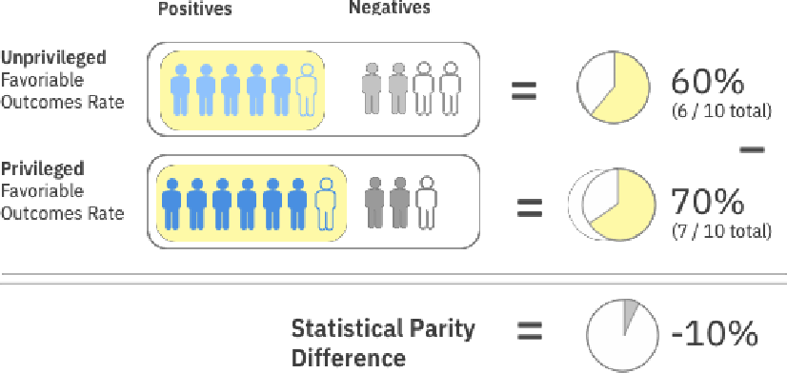
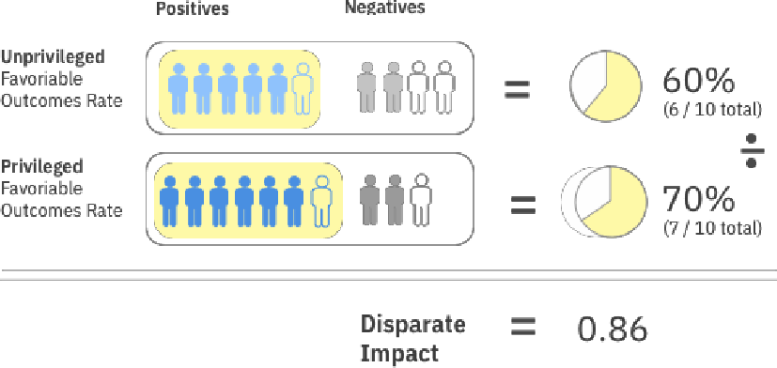
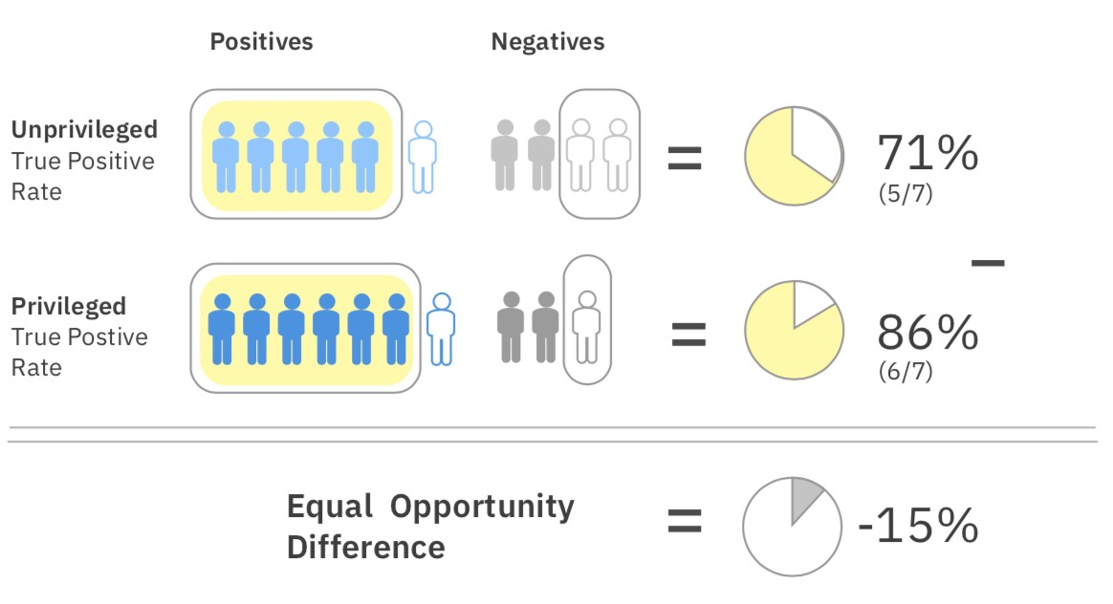
INTRODUCTION- AIF360 FAIRNESS METRICS
Statistical Parity Difference
Disparate Impact
Equal Opportunity Difference
Notes:
Over 70 metrics. Some of the metrics are explained below.
Statistical Parity Difference – The difference that the privileged and unprivileged classes get a particular outcome. The statistical parity basically is an equity measure where members of a group have equal chance of having the same outcome.
Disparate Impact - Ratio of the favourable outcomes for the unprivileged group to the privileged group.
Equal Opportunity difference – True positivity rate of the unprivileged class to the privileged class. This ensures that everyone has equal opportunity towards the outcome.

Slide 13

INTRODUCTION- AIF360 FAIRNESS APPLICATION in AI/ML PIPELINE
Data Understanding
Predictions
Test Data
Feature Engineering
Evaluation
Final Model
Deployment
Raw Data
Train Data
Model
Production Data
Pre-Processing
Bias mitigation algorithms applied before model is run
In-Processing
Bias mitigation algorithms applied while model is run
Post-Processing
Bias mitigation algorithms applied to results
Notes:
Pre-Process : The bias mitigation algorithm is applied to the dataset before a model is run on the dataset. This is used if we want to fix the data before the model is run. This is the most optimal and easiest way to mitigate bias.
In-Process : The bias mitigation algorithm is applied to the dataset while model is run on the dataset, this is basically fixing the classifier to mitigate bias.
Post-Process : The bias mitigation algorithm is applied to the dataset after a model is run on the dataset. This is carried out on the predictions or on the results. Usually followed where the system is a Blackbox.

Slide 14
INTRODUCTION- AIF360 ALGORITHMS
Pre-Processing Algorithms
Reweighing
Disparate Impact Remover
Optimized Pre-processing
Learning Fair Representations
In-Processing Algorithms
Adversarial Debiasing
Prejudice Remover
Meta Fair Classifier
Post-Processing Algorithms
Reject Option Classification
Calibrated Equalized Odds
Equalized Odds
Notes:
Pre-Processing Algorithms
Reweighing :Modifies the weights of different training examples
Disparate Impact Remover: Edits feature values to improve group fairness
Optimized Pre-processing: Modifies training data features & labels
Learning Fair Representations: Learns fair representations by obfuscating(evading) information about protected attributes
In-Processing Algorithms
Adversarial Debiasing: Uses adversarial techniques to maximize accuracy & reduce evidence of protected attributes in predictions
Prejudice Remover: Adds a discrimination-aware regularization term to the learning objective
Meta Fair Classifier: Takes the fairness metric as part of the input & returns a classifier optimized for the metric
Post-Processing Algorithms
Reject Option Classification: Changes predictions from a classifier to make them fairer
Calibrated Equalized Odds: Optimizes over calibrated classifier score outputs that lead to fair output labels
Equalized Odds: Modifies the predicted label using an optimization scheme to make predictions fairer

Slide 15
INTRODUCTION- PRE-PROCESSING ALGORITHMS - OPTIMAL
Reweighing
Modifies weights applied to the training set as such its ideal when you can not change the values.
Disparate Impact Remover & Optimized Pre-Processing
Creates modified dataset as such is more transparent than others. Edits feature values to improve group fairness.
Learning Fair Representations
Creates modified dataset in latent space. Learns fair representations by obfuscating information about protected attributes.

Slide 16
INTRODUCTION- In-PROCESSING ALGORITHMS
Adversarial Debiasing
Uses adversarial techniques to maximize accuracy & reduce evidence of protected attributes in predictions
Prejudice Remover
Adds a discrimination-aware regularization term to the learning objective
Meta Fair Classifier
Takes the fairness metric as part of the input & returns a classifier optimized for the metric

Slide 17
INTRODUCTION- POST-PROCESSING ALGORITHMS
Reject Option Classification
Changes predictions from a classifier to make them fairer
Calibrated Equalized Odds
Optimizes over calibrated classifier score outputs that lead to fair output labels
Equalized Odds
Modifies the predicted label using an optimization scheme to make predictions fairer

Slide 18
INTRODUCTION- AIF360 USAGE GUIDELINES
Below are the basic guidelines while working to mitigate bias in a project.
Work with your stakeholders early to define fairness, protected attributes & thresholds
Apply the earliest mitigation in the pipeline that you have permission to apply
Check for bias as often as possible using any metrics that are applicable
Caveat: AIF360 should only be used with well defined data sets & well defined use cases
Notes:
This slide gives a basic guideline on how we can approach an AI fairness problem.
We need to first identify the protected and privileged attributes based on the fairness definitions applicable to our case.
Then we will apply the respective algorithm in the AI pipeline where we have access. It is always good to follow pre-process algorithms if possible.
Finally we can check the bias metrics after applying the mitigation algorithm.
A general rule of thumb is that the AIF360 algorithms should only be applied to well defined data and well defined use case. A little understanding of bias is required for the success of the AIF360 algorithms. The users need to make sure where they can apply on what protected variables etc.,

Slide 19
AIF360 USE CASE Bank Churn Python Tutorial
LIVE DEMO

Slide 20
LIVE DEMO
Use Case / Data Used
Required Packages
Data Exploration
Data Preparation
Bias Statistics – Original Dataset
Disparate Impact Remover
Trained Model- Logistic Regression
Bias Statistics – Transformed Dataset

Slide 21
LIVE DEMO – USE CASE/ DATA USED
Purpose : Demonstrate AIF360 Applicability
Goal : To reduce bias

Slide 22
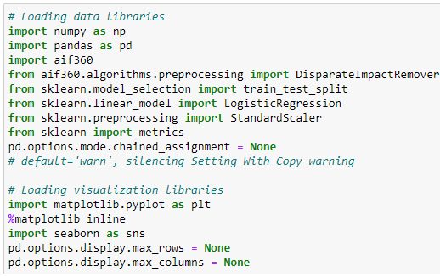
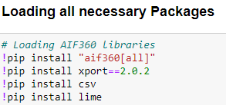
LIVE DEMO – REQUIRED PACKAGES

Slide 23
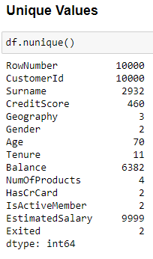
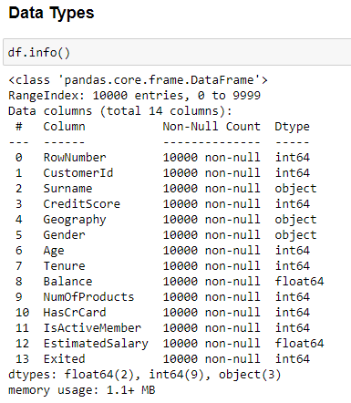
LIVE DEMO – DATA EXPLORATION

Slide 24
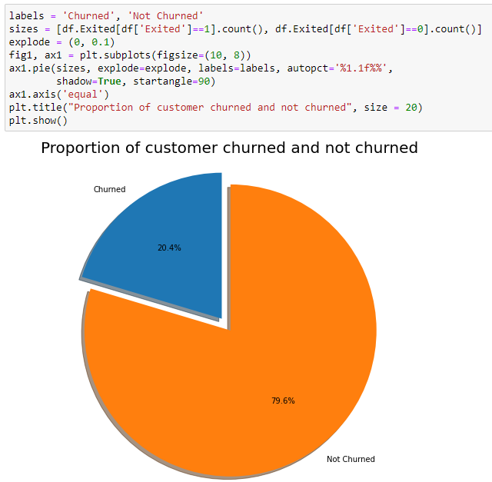
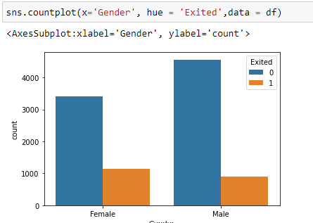
LIVE DEMO – DATA EXPLORATION

Slide 25
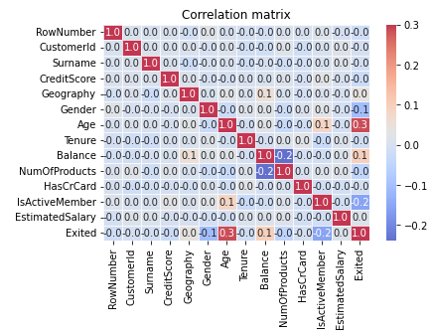
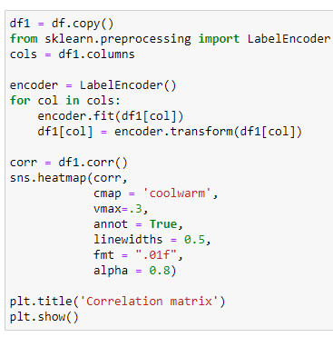
LIVE DEMO – DATA EXPLORATION

Slide 26
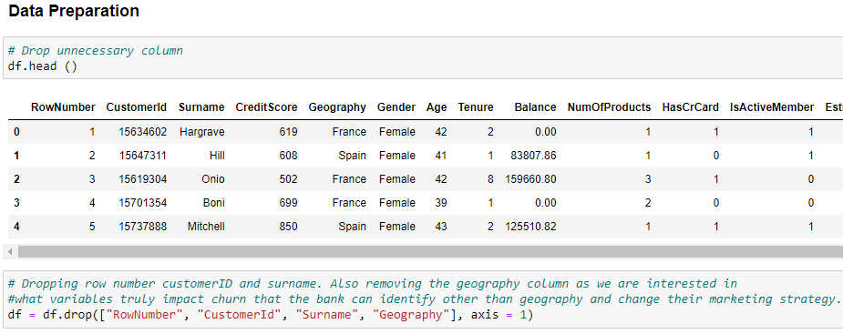
LIVE DEMO – DATA PREPARATION

Slide 27
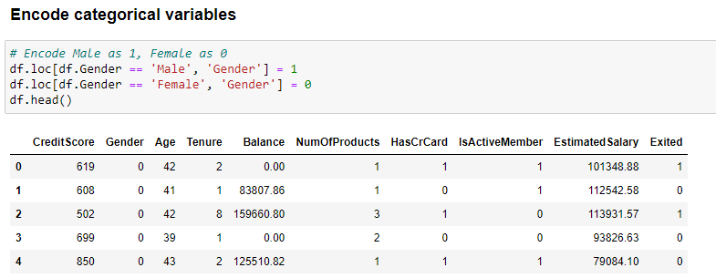
LIVE DEMO – DATA PREPARATION

Slide 28
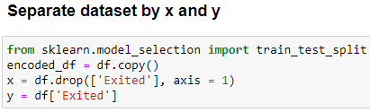
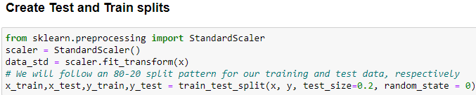
LIVE DEMO – DATA PREPARATION

Slide 29
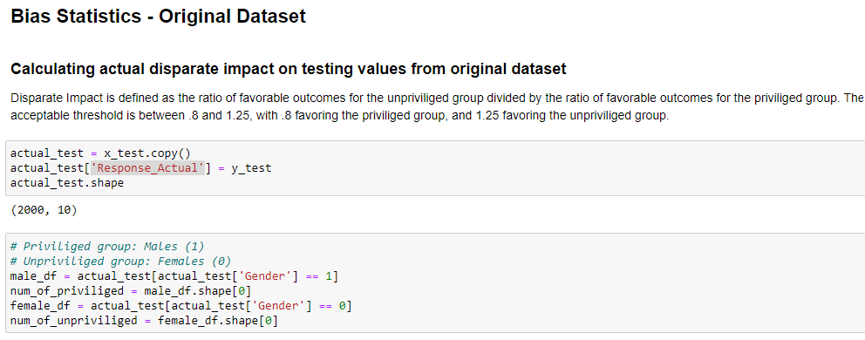
LIVE DEMO – BIAS STATISTICS ORIGINAL DATASET

Slide 30
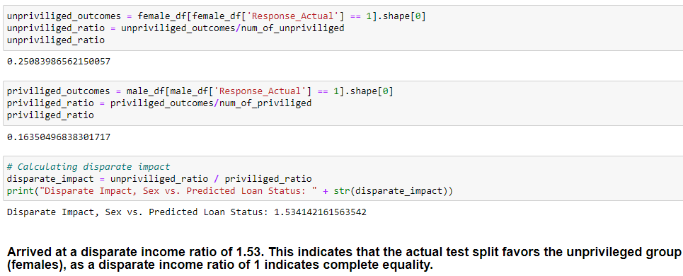
LIVE DEMO – BIAS STATISTICS ORIGINAL DATASET

Slide 31
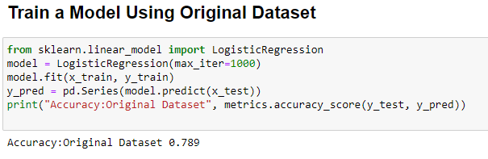
LIVE DEMO – TRAINED MODEL – ORIGINAL DATASET

Slide 32
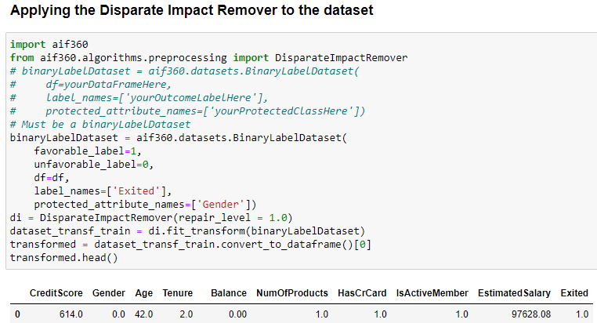
LIVE DEMO – BIAS MITIGATION – DISPARATE IMPACT REMOVER

Slide 33
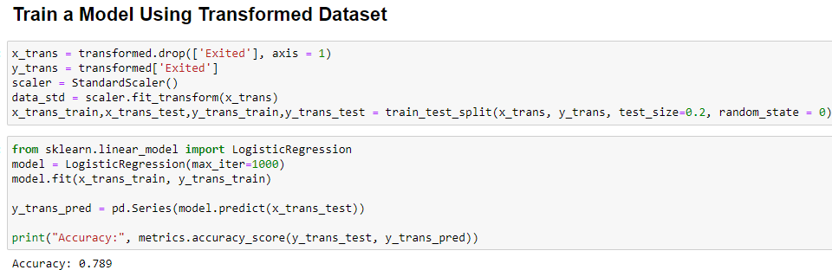
LIVE DEMO – TRAINED MODEL – TRANSFORMED DATASET

Slide 34
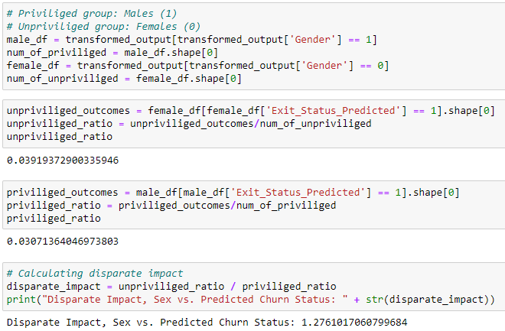
LIVE DEMO – BIAS STATISTICS TRANSFORMED DATASET

Slide 35
RESULTS – BANKCHURN DATASET
BANK CHURN DATASET
ENTITY\ DATASET | ORIGINAL | TRANSFORMED
DISPARATE IMPACT | 1.53 | 1.27
ACCURACY - LOGISTIC | 0.789 | 0.789

Slide 36
RESULTS – HEART DISEASE - DATASET
BANK HEART DISEASE DATASET
ENTITY\ DATASET | ORIGINAL | TRANSFORMED
DISPARATE IMPACT | 1.81 | 1.07
ACCURACY - LOGISTIC | 0.859 | 0.878

Slide 37
INTRODUCTION- AIF360 BIAS ALGORITHM TRADE-OFFS
Trade-Off between accuracy vs bias statistics.
Dataset and business case has to be well-defined.
Careful judgment of which algorithm to follow.
Notes:
As seen from results above we have seen that though the disparate impact values have improved the accuracy remained same or improved.
This can not be the case every time and often we need to make a call for accuracy as it may reduce after applying the bias algorithms.
Also the biggest trade-off is that the dataset should be well-defined, clean and the business case also should be well-defined to identify protected/privileged attributes for the AIF360 algorithm to work.
It’s the user responsibility and judgement call whether he will use pre-process, in-process or post-process algorithm. It’s always suggested to use the pre-process algorithms.

Slide 38
WEB RESOURCES
OpenDS4All
https://github.com/odpi/OpenDS4All
https://github.com/odpi/OpenDS4All/tree/master/opends4all-resources/opends4all-ethics
View AI Fairness 360 website
https://aif360.mybluemix.net/

Slide 39
THANK YOU!

